Slide 1
What´s your personality type?
Basic 7 – Unit 8b

Slide 2
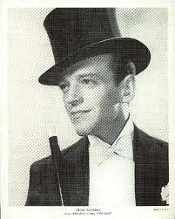
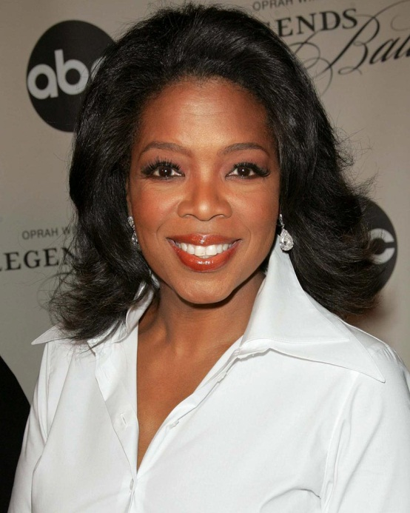
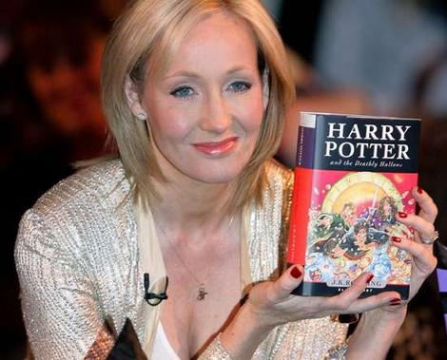
Oprah Winfrey
Fred Astaire
J. K. Rowling

Slide 3
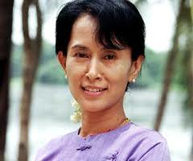
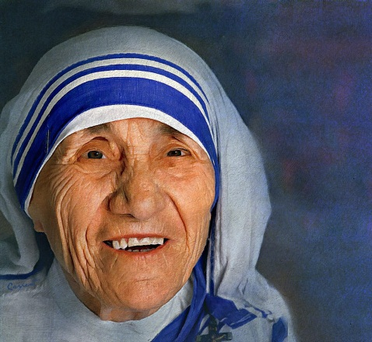
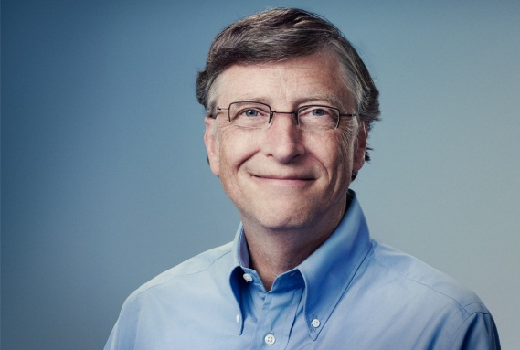
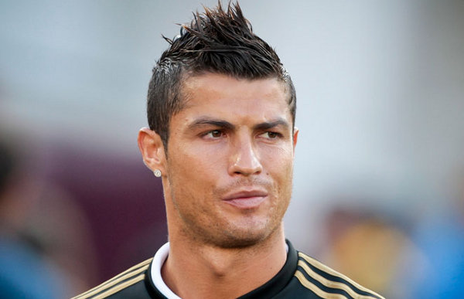
Bill
Teresa
Cristiano
Suu Kyi
Aung San
Gates
Mother
Ronaldo
A
B
C
D

Slide 4
B
Bill
Teresa
C
Cristiano
Suu Kyi
Aung San
Gates
Mother Teresa
Aung San
Suu Kyi
Mother
Ronaldo
Cristiano Ronaldo
Bill Gates
A
D

Slide 5
The Dreamer
The Partner
The Thinker
The Artist
Which group does (name) belong to?
I think (name) belongs to (personality type) group.

Slide 6
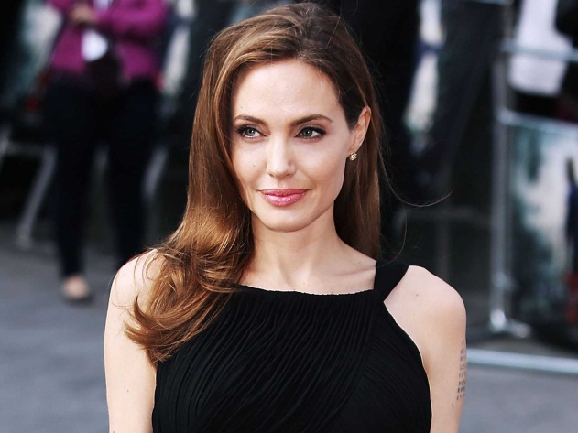
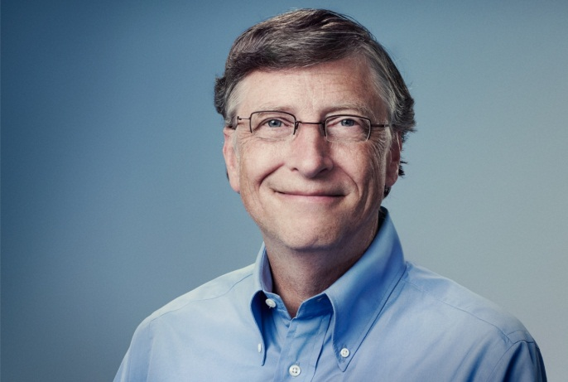
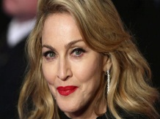
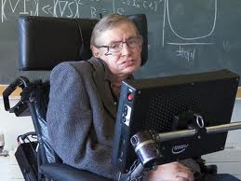
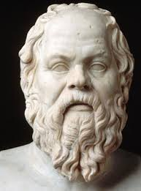
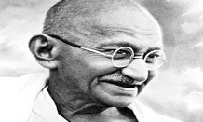

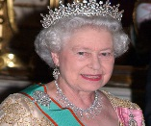

Slide 7
What´s your name?
Why do you think you are a (personality type) ?
I think I am a (personality type) because I ______
Were you surprised you were a (personality type)?
Yes, I was because ______
No, I wasn´t because _____

